Slide 1
CS G526 Project
Presentation 1: Problem statement and works of Malpani, Plaxton and Chankhunthod.

Slide 2

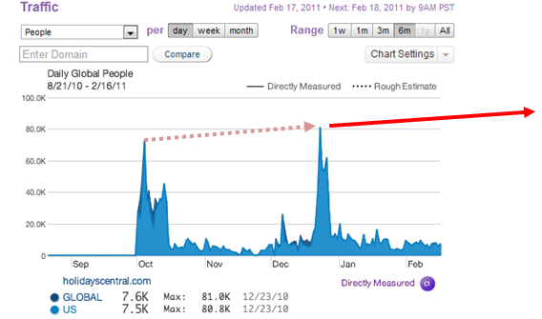
The problem: Internet hot spots
Occur when a large number of clients tries to simultaneously access data from a single web server.
Notes:
Image credits: http://www.webhostingsearch.com/assets/ContentFiles/web-traffic.jpg

Slide 3
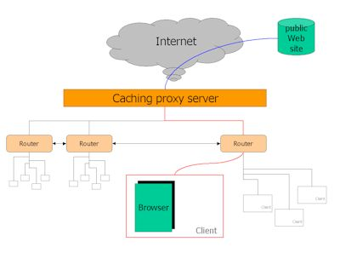
0. Proxy caches: An earlier solution
All requests are passed through a proxy server, which stores copies of frequently requested web pages.
The dilemma
If less users share a cache, caching won’t be effective. When more users share the same cache, the cache itself can become a hot spot!
Notes:
Image credits: http://www.esds.co.in/blog/wp-content/uploads/2015/05/proxy_server_caching.jpg

Slide 4
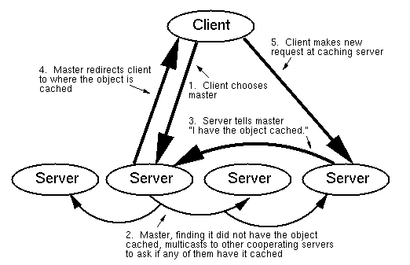
1. The solution by Malpani et al.
Distributed cache servers with load balancing.
The client chooses a master randomly.
If Hit:
Get & Close the connection
Else:
Master multicasts to other servers.
If an other has a Hit
The master redirect the client to this server.
Client gets the content from the new server.
Else:
Timeout. Client gets the object directly from the URL
Malpani, Radhika, Jacob Lorch, and David Berger. "Making world wide web caching servers cooperate." Proceedings of the Fourth International World Wide Web Conference. 1995.

Slide 5
About this approach.
Advantages
Solves the dilemma of caches themselves becoming the hot spots.
Better robustness (No single point of failure)
Disadvantages
As the number of caches grows, the number of messages between caches becomes unmanageable.

Slide 6
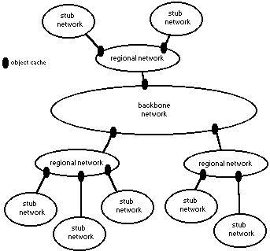
2. A better solution by Chankhunthod et al.
Harvest Cache: using a tree of caches
A cache receives request for a URL
If Hit:
Serve the content.
Else: Await a UDP Hit from (a)siblings and (b)parent:
If wait_time <= 2sec && Hit:
Get the content from (a) or (b) whichever gave the first Hit.
Else:
Await a Hit from the home site.
Chankhunthod, Anawat, et al. A hierarchical internet object cache. No. CU-CS-766-95. COLORADO UNIV AT BOULDER DEPT OF COMPUTER SCIENCE, 1995.

Slide 7
About this approach.
Advantages
Better scalability. (A cache receives page requests only from its children and siblings)
Disadvantages
Same tree is used for all pages => The root receives at least one request per every page requested of the entire tree.

Slide 8
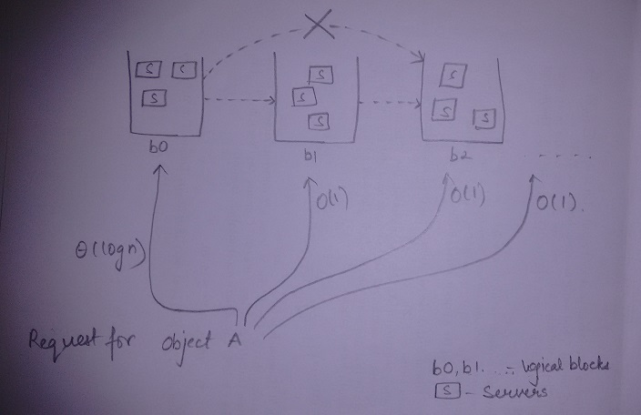
An even better approach by Plaxton et al.

Slide 9
About this approach.
Advantages
Better scalability.
Each page has a different tree. The root won’t get swamped.
Disadvantages
Since this algorithm used swamping as a feature to trigger replication, in real world scenario that will cause a lot of delay (systems needs to be rebooted)
Algorithm also required that all communications be synchronous & set of caches are know to all users.

